Slide 1
AES

Slide 2
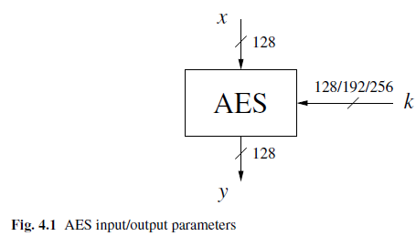
Overview of AES
The AES cipher is almost identical to the block cipher Rijndael. The Rijndael block and key size vary between 128, 192 and 256 bits. However, the AES standard only calls for a block size of 128 bits. Hence, only Rijndael with a block length of 128 bits is known as the AES algorithm.

Slide 3
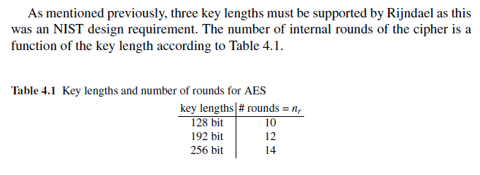
Overview of AES
In contrast to DES, AES does not have a Feistel structure. Feistel networks do not encrypt an entire block per iteration, e.g., in DES, 64/2 = 32 bits are encrypted. in one round.
AES, on the other hand, encrypts all 128 bits in one iteration. This is one reason why it has a comparably small number of rounds.

Slide 4
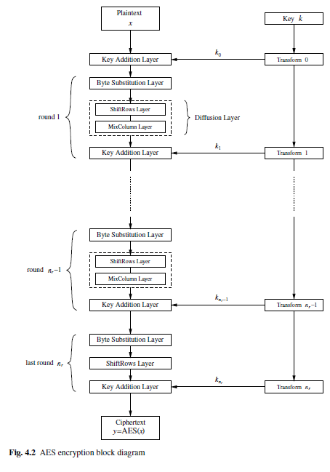
Overview of AES
AES consists of so-called layers. Each layer manipulates all 128 bits of the data path.
The data path is also referred to as the state of the algorithm. There are only three different types of layers.
Each round, with the exception of the first, consists of all three layers as shown in Fig. 4.2: the plaintext is denoted as x, the ciphertext as y and the number of rounds as nr.
Moreover, the last round nr does not make use of the MixColumn transformation, which makes the encryption and decryption scheme symmetric

Slide 5
Overview of AES
We continue with a brief description of the layers:
Key Addition layer: A 128-bit round key, or subkey, which has been derived from the main key in the key schedule, is XORed to the state.
Byte Substitution layer (S-Box): Each element of the state is nonlinearly transformed using lookup tables with special mathematical properties. This introduces confusion to the data, i.e., it assures that changes in individual state bits propagate quickly across the data path.
Diffusion layer: It provides diffusion over all state bits. It consists of two sublayers,both of which perform linear operations:
_x0002_ The ShiftRows layer permutes the data on a byte level.
_x0002_ The MixColumn layer is a matrix operation which combines (mixes) blocks of four bytes.
Similar to DES, the key schedule computes round keys, or subkeys, (k0,k1, . . . ,knr ) from the original AES key.
Galois field computations are needed for all operations within the AES layers.

Slide 6
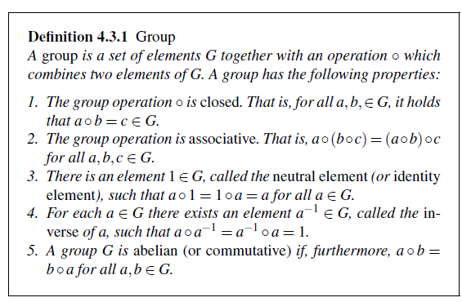
Introduction Galois Field
In AES, Galois field arithmetic is used in most layers, especially in the S-Box and the MixColumn layer.
Existence of Finite Fields: A finite field, sometimes also called Galois field, is a set with a finite number of elements in which we can add, subtract, multiply and invert.
Before we introduce the definition of a field, we first need the concept of a a simpler algebraic structure, a group.

Slide 7
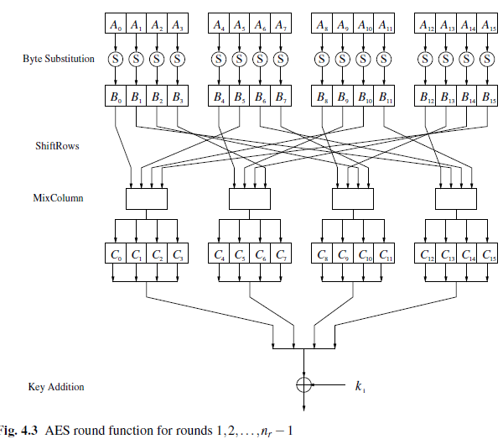
Internal Structure of AES
Figure 4.3 shows the graph of a single AES round. The 16-byte input A0, . . . ,A15 is fed byte-wise into the S-Box. The 16-byte output B0, . . . ,B15 is permuted byte-wise in the ShiftRows layer and mixed by the MixColumn transformation c(x). Finally, the 128-bit subkey ki is XORed with the intermediate result

Slide 8
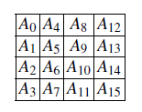
Internal Structure of AES
This is in contrast to DES, which makes heavy use of bit permutation and can thus be considered to have a bit-oriented structure.
In order to understand how the data moves through AES, we first imagine that the state A (i.e., the 128-bit data path) consisting of 16 bytes A0,A1, . . . ,A15 is arranged in a four-by-four byte matrix:

Slide 9
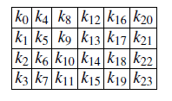
Internal Structure of AES
AES operates on elements, columns or rows of the current state matrix. Similarly, the key bytes are arranged into a matrix with four rows and four (128-bit key), six (192-bit key) or eight (256-bit key) columns. Here is, as an example, the state matrix of a 192-bit key:

Slide 10

Internal Structure of AES
Byte Subtitution Layer: The Byte Substitution layer can be viewed as a row of 16 parallel S-Boxes, each with 8 input and output bits. Note that all 16 S-Boxes are identical, unlike DES where eight different S-Boxes are used. In the layer, each state byte Ai is replaced, i.e., substituted, by another byte Bi:

Slide 11
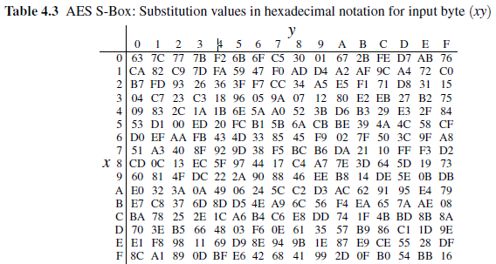
Internal Structure of AES
The S-Box substitution is a bijective mapping, i.e., each of the 2^8 = 256 possible input elements is one-to-one mapped to one output element. This allows us to uniquely reverse the S-Box, which is needed for decryption. In software implementations the S-Box is usually realized as a 256-by-8 bit lookup table with fixed entries, as given in Table 4.3

Slide 12

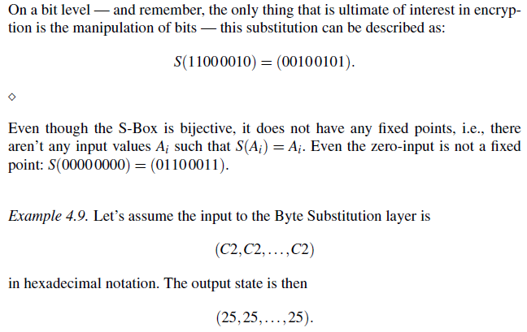
Internal Structure of AES

Slide 13
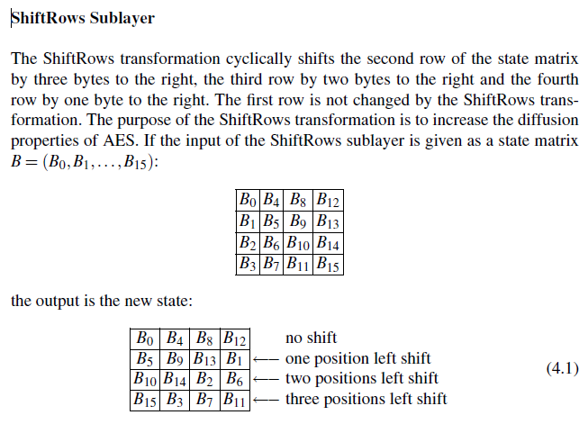
Internal Structure of AES
Diffusion Layer:In AES, the Diffusion layer consists of two sublayers, the ShiftRows transformation and the MixColumn transformation.

Slide 14
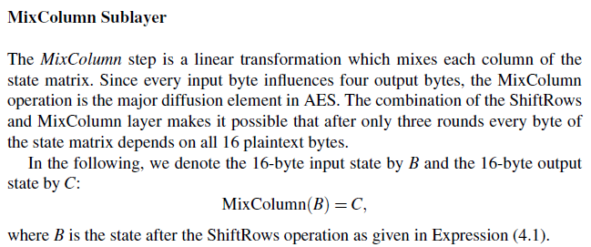
Internal Structure of AES

Slide 15
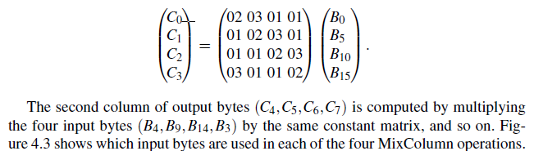
Internal Structure of AES
Now, each 4-byte column is considered as a vector and multiplied by a fixed 4×4 matrix. The matrix contains constant entries. Multiplication and addition of the coefficients is done in GF(2^8). As an example, we show how the first four output bytes are computed:

Slide 16
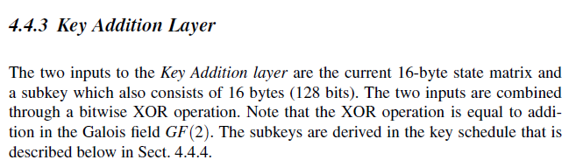
Internal Structure of AES

Slide 17
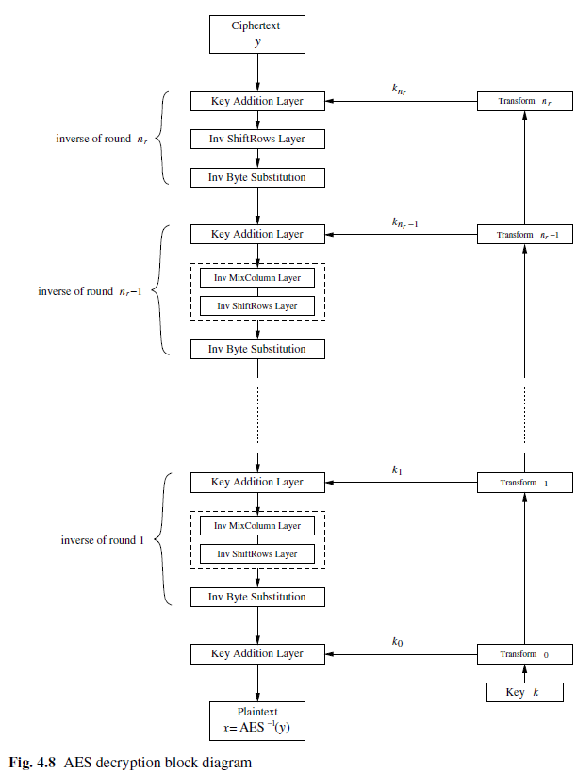
Decryption in AES

Slide 18
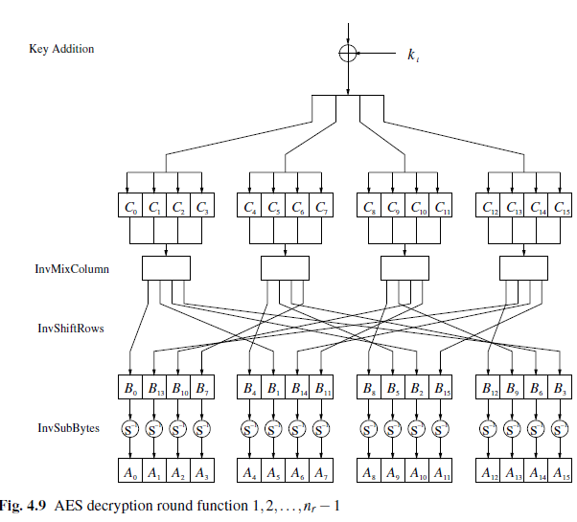
Decryption in AES

Slide 19
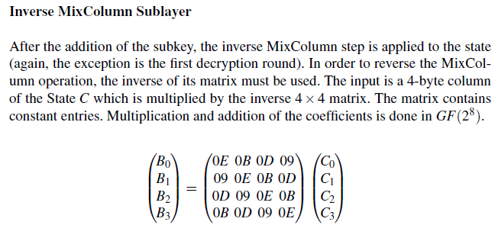
Decryption in AES

Slide 20
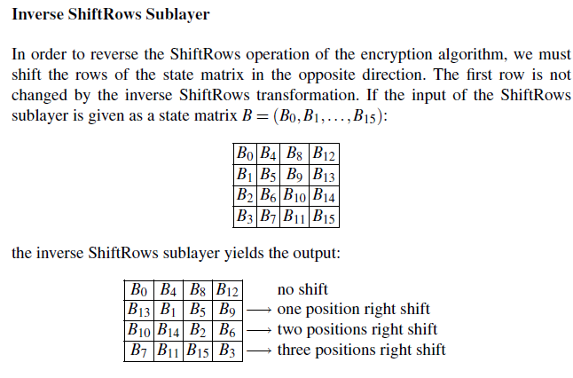
Decryption in AES

Slide 21
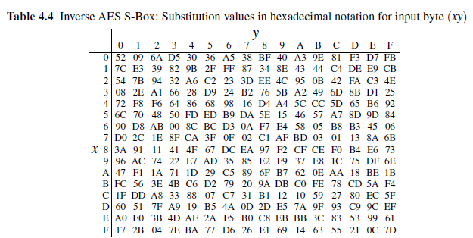
Inverse Byte Substitution Layer

